Slide 1

Learn IELTS for just $1 at https://bit.ly/3p2W44z
IELTS Reading: Hints & Practice

Slide 2
Before we begin…
Learn IELTS for just $1 at https://bit.ly/3p2W44z
This is a free lesson to help you improve your IELTS Reading skills
Please help to support us by…
Signing up for the Stax English $1 IELTS Reading & Listening online course here: https://bit.ly/3p2W44z
Liking us on Facebook here: https://www.facebook.com/staxenglish
Downloading our English Games app for Android at: https://shorturl.at/ioCQ9

Slide 3

Learn IELTS for just $1 at https://bit.ly/3p2W44z

Slide 4
Skills required:
Learn IELTS for just $1 at https://bit.ly/3p2W44z
Prediction
Finding specific information
Identifying opinion

Slide 5
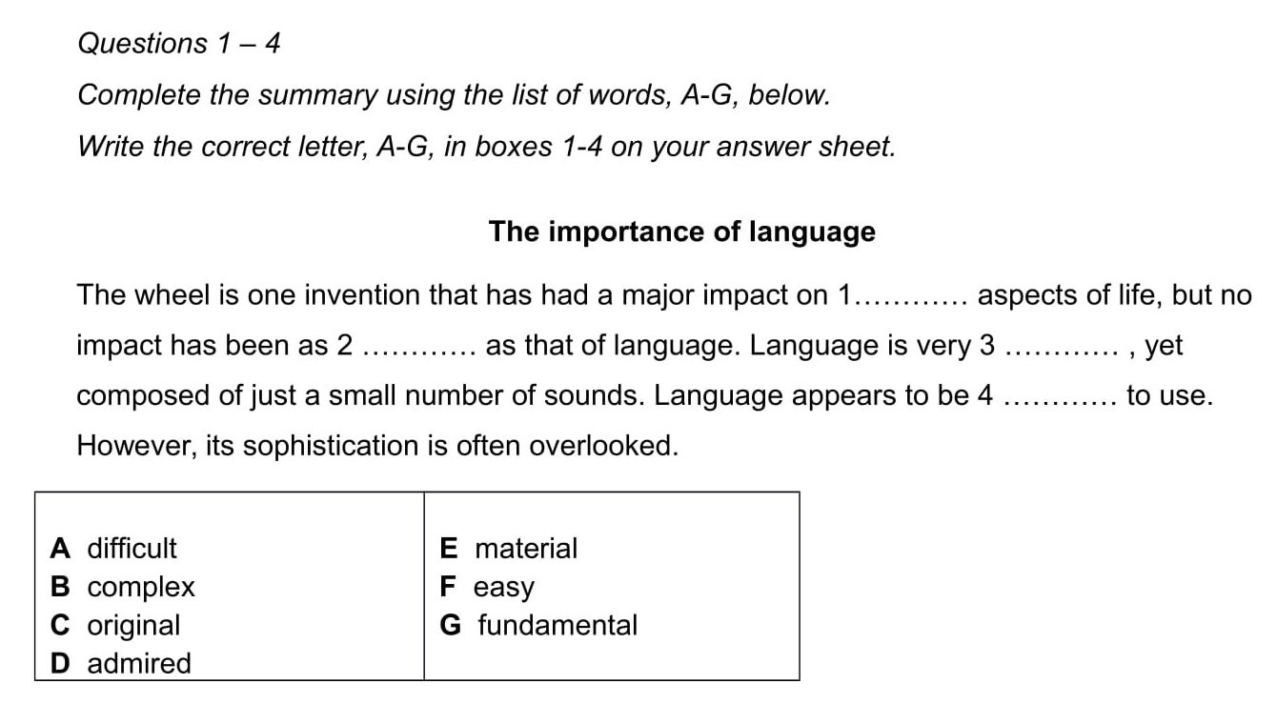
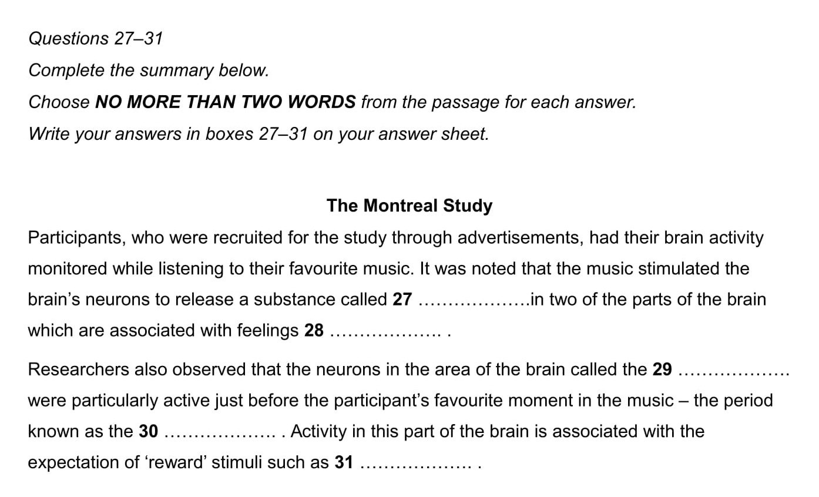
Prediction
Learn IELTS for just $1 at https://bit.ly/3p2W44z
Prediction is the ability to make an early educated guess about what type of word is likely to go in the blank space
When you read the summary, try to predict the type of word you’ll need to fill each gap from the context of the sentence. Is it an adjective, a noun, a verb, etc?
Doing this will make it much easier to spot the correct word because you’ll have a big clue as to what you’re looking for.
If you are able to predict the word form, e.g. an adjective, look for the adjective closest to the key word in the text. This will probably be the word you need or a synonym of it. I’ll illustrate this when we come to the example exercise.

Slide 6
Prediction
Learn IELTS for just $1 at https://bit.ly/3p2W44z
All adjectives. All nouns.

Slide 7
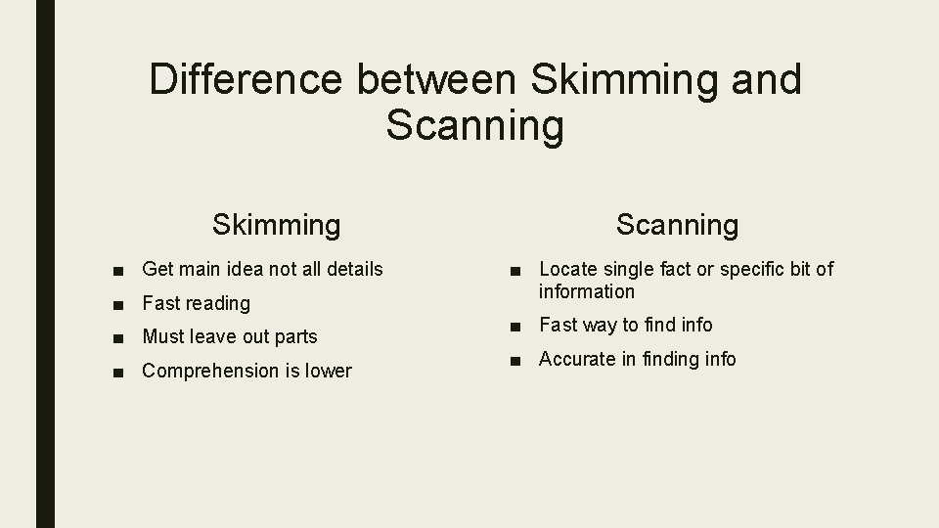
Finding specific information
Learn IELTS for just $1 at https://bit.ly/3p2W44z
You will first have to be able to skim the reading text to get a general meaning of each paragraph.
You will also have to scan for specific words within the paragraphs. It is more likely that you will be looking for synonyms (different words that mean the same or nearly the same) and paraphrases rather than keywords from the question statements.

Slide 8
Finding specific information
Learn IELTS for just $1 at https://bit.ly/3p2W44z
Specific information could be a noun: names, dates, places – This information will not change.
Specific information could also be an adjective or a verb – This information can change.
For this reason, it’s important to brush up on paraphrasing and synonyms.

Slide 9
Identifying opinion
Learn IELTS for just $1 at https://bit.ly/3p2W44z
Remember, the writer’s opinion may not represent the facts.
It may not be the same as your opinion.
It’s important to only draw your answers from the text.
With this IELTS reading question type, there will be several given statements. Your job is to decide whether they agree with the writer’s views or not. Your decision should be based only on the information from the text. There will be 3 answers: YES, NO and NOT GIVEN
YES – If the statement agrees with or is the same as the writer’s opinions and claims that you see from the reading text
NO – If the statement disagrees with or contradicts the writer’s opinions and claims
NOT GIVEN – If you cannot find any clue from the text to decide what the writer’s opinions are.

Slide 10
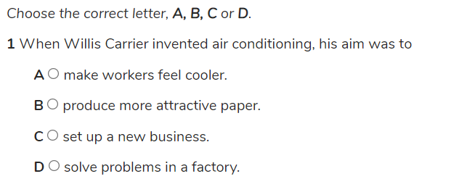
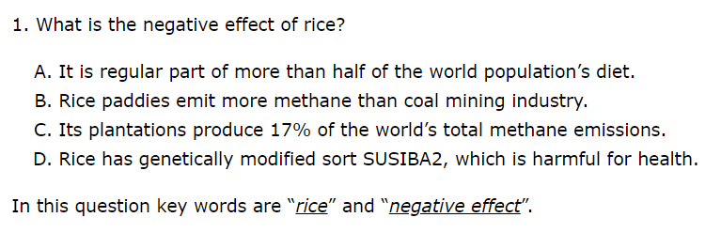
Types of questions
Learn IELTS for just $1 at https://bit.ly/3p2W44z
Sentence completion:
Multiple choice:

Slide 11
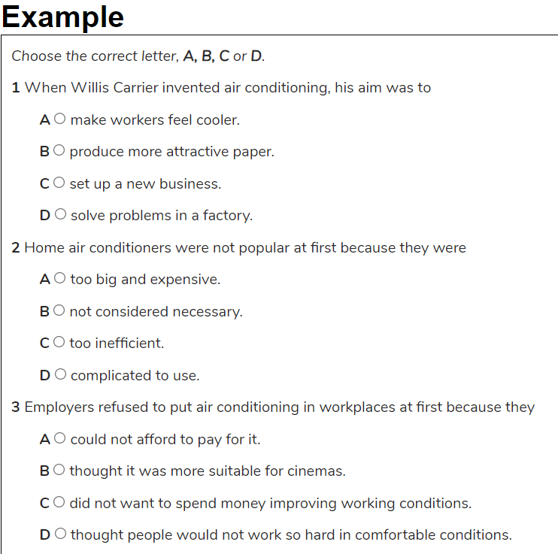
Sentence completion
Learn IELTS for just $1 at https://bit.ly/3p2W44z

Slide 12
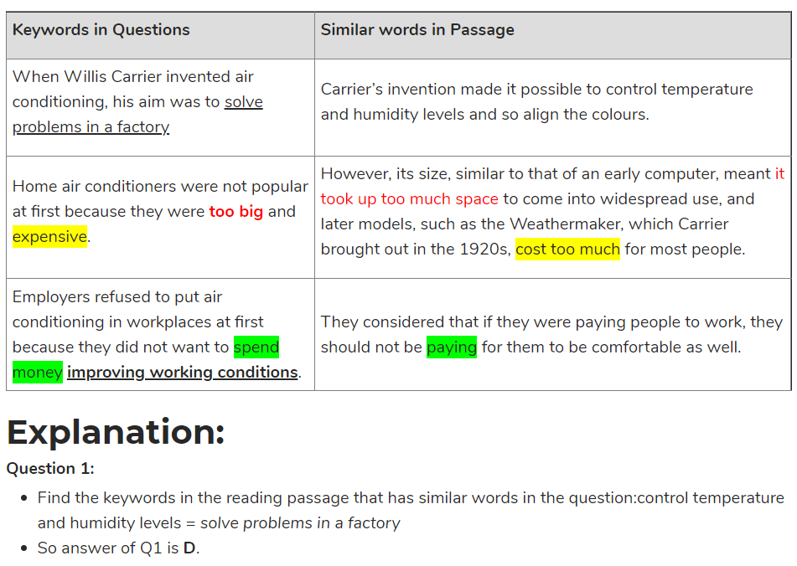
Sentence completion
Learn IELTS for just $1 at https://bit.ly/3p2W44z

Slide 13
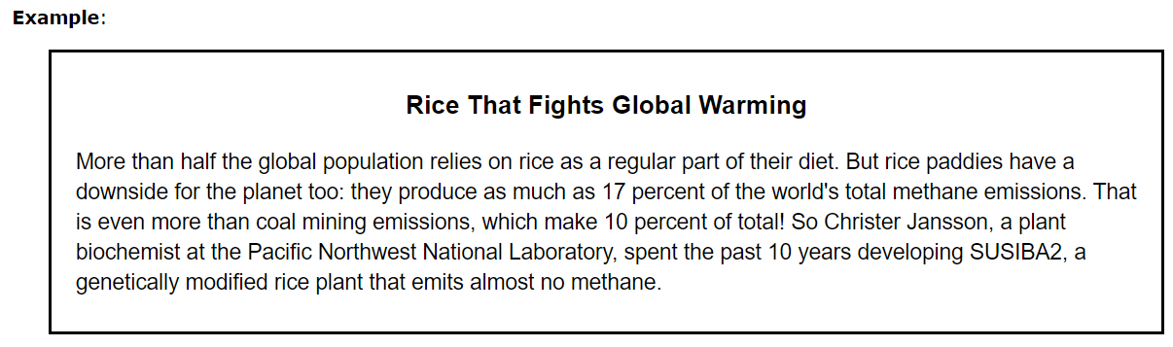
Multiple choice
Learn IELTS for just $1 at https://bit.ly/3p2W44z

Slide 14
Multiple choice
Learn IELTS for just $1 at https://bit.ly/3p2W44z

Slide 15
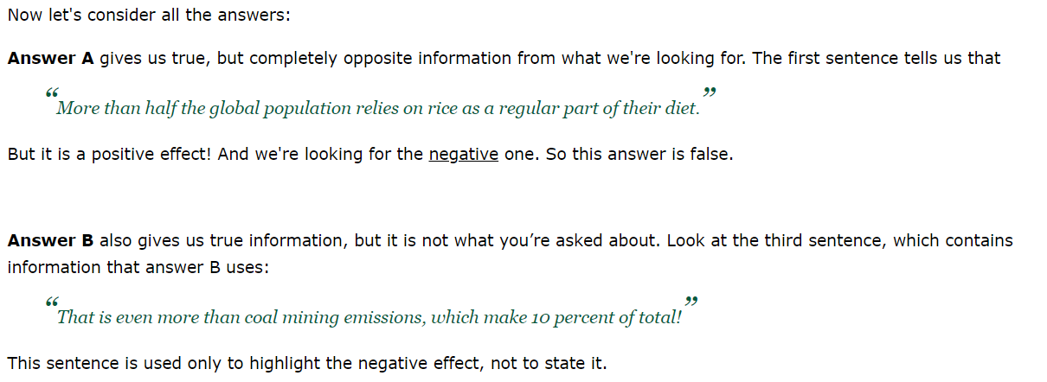
Multiple choice
Learn IELTS for just $1 at https://bit.ly/3p2W44z

Slide 16
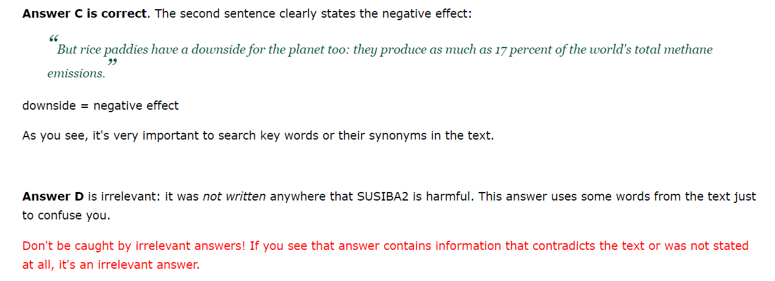
Multiple choice
Learn IELTS for just $1 at https://bit.ly/3p2W44z

Slide 17
You will be tested on:
Learn IELTS for just $1 at https://bit.ly/3p2W44z
Completing a diagram, table or summary
Finding specific information
Identifying the writer's opinion
Following key arguments
Identifying the writer's purpose

Slide 18
Keys skills to practice:
Learn IELTS for just $1 at https://bit.ly/3p2W44z
Expanding your vocabulary
Learning synonyms
Paraphrasing

Slide 19
Tips:
Learn IELTS for just $1 at https://bit.ly/3p2W44z
Don't expect to understand every word
Whilst it is important to expand your vocabulary base, remember that the most common 100 words in the English language make up 50% of the language.
The most common 1000 words make up 99% of the language.
There are somewhere between 300,000-1,000,000 words in the English language, most of which are rarely used.
You are not expected to know all of them.
You can make an educated guess at the meaning of a word based on it’s context.

Slide 20
Tips:
Learn IELTS for just $1 at https://bit.ly/3p2W44z
Practice reading, not “tricks”
In my long and varied experience as an IELTS teacher, I have found that far too much emphasis is placed on teaching people ‘tricks’ to fool an IELTS examiner.
IELTS examiners know when you do not understand a word. They cannot be tricked so easily, so don’t focus so much on guesswork, using buzzwords that sound clever, or speed reading.
Just read more.
The more English you consume (whether by reading, watching videos, listening to podcasts, speaking or even playing English games), the more you will be able to produce.

Slide 21
Tips:
Learn IELTS for just $1 at https://bit.ly/3p2W44z
Read the instructions VERY carefully
It’s amazing how many students have lost points just because they didn’t read the instructions properly.
ONE WORD means ONE WORD!
TWO WORDS AND A NUMBER means TWO WORDS AND A NUMBER!
Do not write anything less, or anything extra.
Example: The sentence ‘thirty two cars’ is ONE WORD AND A NUMBER.

Slide 22
Tips:
Learn IELTS for just $1 at https://bit.ly/3p2W44z
Do not panic!
Don't waste time on one question. If you are struggling, move on to the next question and come back to it later. You will feel less stressed and better able to think if you get some other answers correct and return to the difficult ones later.

Slide 23
Tips:
Learn IELTS for just $1 at https://bit.ly/3p2W44z
Practice vocabulary, synonyms and paraphrasing
Read a text in English
Note down the words you do not understand
Say the words aloud
Look up the words in a dictionary
Find some synonyms for the words
Use the words in a sentence of your own
Paraphrase the original sentence you saw
Review the words regularly to reinforce your knowledge

Slide 24
Tips:
Learn IELTS for just $1 at https://bit.ly/3p2W44z
Timing matters
Try to do each section in 20 minutes-
16-17 minutes to read/answer
3-4 minutes to check your answers

Slide 25
Tips:
Learn IELTS for just $1 at https://bit.ly/3p2W44z
Don’t rely on your own knowledge to answer the text!
Remember, the questions are about what you read in the text.
So, if the text is about engineering, and you happen to be an engineer, don’t try to answer the questions based on your expert knowledge of engineering.
Texts may be opinion based and so your personal knowledge of the subject will have no bearing on the answers.

Slide 26
Tips:
Learn IELTS for just $1 at https://bit.ly/3p2W44z
Attempt every question
Do not leave anything blank when answering questions. Try to answer everything. If you absolutely must, hazard a guess on those really tough answers.

Slide 27
Tips:
Learn IELTS for just $1 at https://bit.ly/3p2W44z
Practice slowly and regularly.
We learn best in the first 40 minutes of study.
It is infinitely better to study in small chunks, every day, rather than study for 6 hours a day in cram sessions.
You will only stress yourself out.
Make time to study. Read diverse and interesting texts. Do not overwhelm yourself.

Slide 28
Let’s take a look at a sample paper.
Learn IELTS for just $1 at https://bit.ly/3p2W44z
Now we’re going to look at an example question, and go through it step-by-step…

Slide 29
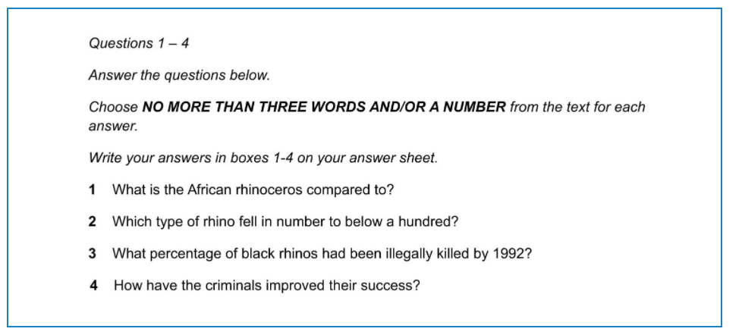
First of all, read the instructions carefully…
Learn IELTS for just $1 at https://bit.ly/3p2W44z

Slide 30
First of all, read the instructions carefully…
Learn IELTS for just $1 at https://bit.ly/3p2W44z

Slide 31
Next, read the questions.
Learn IELTS for just $1 at https://bit.ly/3p2W44z

Slide 32
Think about the key words.
Learn IELTS for just $1 at https://bit.ly/3p2W44z

Slide 33
Which ones will stay the same?
Learn IELTS for just $1 at https://bit.ly/3p2W44z

Slide 34
Which ones may change?
Learn IELTS for just $1 at https://bit.ly/3p2W44z

Slide 35
Think about potential synonyms/paraphrasing
Learn IELTS for just $1 at https://bit.ly/3p2W44z
Compared to – like, similar to, looks like
Below a hundred – Under, Less than, Lower than, Fewer than 100
Illegally – Criminally, Against the law, Extrajudicially,
Criminals – Crime, poachers, illegal enterprise,
Improved – Helped, gotten better, expanded, grown
Success – Accomplish, attain, grown, expand, succeed

Slide 36
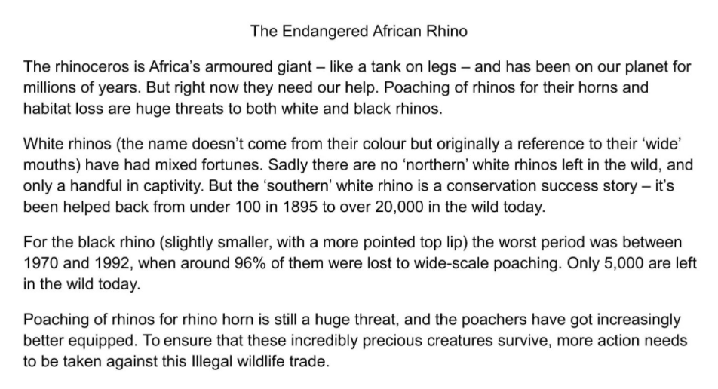
Skim read the article
Learn IELTS for just $1 at https://bit.ly/3p2W44z

Slide 37
Re-read question 1, then look for the synonyms
Learn IELTS for just $1 at https://bit.ly/3p2W44z
Compared to – like, similar to, looks like
Below a hundred – Under, Less than, Lower than, Fewer than 100
Illegally – Criminally, Against the law, Extrajudicially,
Criminals – Crime, poachers, illegal enterprise,
Improved – Helped, gotten better, expanded, grown
Success – Accomplish, attain, grown, expand, succeed

Slide 38
Look for the answer…
Learn IELTS for just $1 at https://bit.ly/3p2W44z

Slide 39
There it is…
Learn IELTS for just $1 at https://bit.ly/3p2W44z

Slide 40
Remember the instructions!
Learn IELTS for just $1 at https://bit.ly/3p2W44z

Slide 41
‘Like a tank’ or ‘A tank’ are acceptable…
Learn IELTS for just $1 at https://bit.ly/3p2W44z

Slide 42
‘Like a tank on legs’ is not acceptable.
Learn IELTS for just $1 at https://bit.ly/3p2W44z

Slide 43
Let’s try question 2…
Learn IELTS for just $1 at https://bit.ly/3p2W44z
Compared to – like, similar to, looks like
Below a hundred – Under, Less than, Lower than, Fewer than 100
Illegally – Criminally, Against the law, Extrajudicially,
Criminals – Crime, poachers, illegal enterprise,
Improved – Helped, gotten better, expanded, grown
Success – Accomplish, attain, grown, expand, succeed

Slide 44
Look for the answer…
Learn IELTS for just $1 at https://bit.ly/3p2W44z

Slide 45
There it is….
Learn IELTS for just $1 at https://bit.ly/3p2W44z

Slide 46
Let’s try question 3…
Learn IELTS for just $1 at https://bit.ly/3p2W44z
Compared to – like, similar to, looks like
Below a hundred – Under, Less than, Lower than, Fewer than 100
Illegally – Criminally, Against the law, Extrajudicially,
Criminals – Crime, poachers, illegal enterprise,
Improved – Helped, gotten better, expanded, grown
Success – Accomplish, attain, grown, expand, succeed

Slide 47
Remember, we’re looking for the ‘Black Rhino’, not the ‘White rhino’.
Learn IELTS for just $1 at https://bit.ly/3p2W44z
Compared to – like, similar to, looks like
Below a hundred – Under, Less than, Lower than, Fewer than 100
Illegally – Criminally, Against the law, Extrajudicially,
Criminals – Crime, poachers, illegal enterprise,
Improved – Helped, gotten better, expanded, grown
Success – Accomplish, attain, grown, expand, succeed

Slide 48
Look for the answer…
Learn IELTS for just $1 at https://bit.ly/3p2W44z

Slide 49
There it is….
Learn IELTS for just $1 at https://bit.ly/3p2W44z

Slide 50
Let’s try question 4…
Learn IELTS for just $1 at https://bit.ly/3p2W44z
Compared to – like, similar to, looks like
Below a hundred – Under, Less than, Lower than, Fewer than 100
Illegally – Criminally, Against the law, Extrajudicially,
Criminals – Crime, poachers, illegal enterprise,
Improved – Helped, gotten better, expanded, grown
Success – Accomplish, attain, grown, expand, succeed

Slide 51
Look for the answer…
Learn IELTS for just $1 at https://bit.ly/3p2W44z

Slide 52
There it is….
Learn IELTS for just $1 at https://bit.ly/3p2W44z

Slide 53
Any questions?
Learn IELTS for just $1 at https://bit.ly/3p2W44z

Slide 54
We hope you enjoyed this free lesson.
Learn IELTS for just $1 at https://bit.ly/3p2W44z
If you’ve enjoyed this lesson and would like to improve your reading skills…
Sign up for the Stax English $1 IELTS Reading & Listening online course here: https://bit.ly/3p2W44z
Like us on Facebook here: https://www.facebook.com/staxenglish
Download our English Games app for Android at: https://shorturl.at/ioCQ9

